Slide 1

Customer Retention Analysis
E-retail factors for customer activation and retention

Slide 2
Introduction:
Nowadays, online shopping is a fast-growing phenomenon. Growing numbers of consumers shop online to purchase goods and services, gather product information or even browse for enjoyment.
Online shopping environments are therefore playing an increasing role in the overall relationship between marketers and their consumers.
That is, consumer-purchases are mainly based on the cyberspace appearance such as pictures, images, quality information and video clips of the product, not on the actual experience. Due to this internet penetration, customers can just sit at their home, place their orders, pay via credit card, and wait until the goods are delivered to their home and they can easily shop their needy products via e-commerce rather than in physical stores.

Slide 3
Business Problem Framing:
Five major factors that contributed to the success of an e-commerce store have been identified as: service quality, system quality, information quality, trust and net benefit.
The combination of both utilitarian value and hedonistic values are needed to affect the repeat purchase intention (loyalty) positively. The data is collected from the Indian online shoppers.
Human nature is such that once one want of individual is satisfied he or she begins to think about satisfying another want and this process is a neverending cycle as although human needs are limited but human wants are unlimited. Hedonic consumption and utilitarian consumption tries to address this issue but they are not one and the same thing and that is the reason why one should understand the difference between hedonic consumption and utilitarian consumption –

Slide 4
Hedonic Consumption Vs Utilitarian Consumption
Hedonic consumption refers to that consumption which is done by an individual after his or her basic needs like food, water, safety needs are satisfied but utilitarian consumption is that consumption that is necessary for the survival of an individual and without satisfying this consumption needs an individual will not be able to survive.
An example of hedonic consumption would be a consumer buying an iPhone, or purchasing 3D television, or purchasing a BMW car, in simple words when the consumer has excess money he or she go for purchasing expensive brands as there is no limit to the wants of individuals. An example of utilitarian consumption is suppose an individual needs mobile as he or she is far away from the home than he or she decides to purchase a normal mobile instead of iPhone is consumer fulfilling utilitarian consumption or consumer eating food in a regular restaurant instead of eating food in the 5-star hotel is an example of utilitarian consumption.

Slide 5
What is Customer Retention?
Customer retention refers to the ability of a company or product to retain its customers over some specified period. High customer retention means customers of the product or business tend to return to, continue to buy or in some other way not defect to another product or business, or to non-use entirely.

Slide 6
How to Measure Customer Retention?
Businesses need to use the following formula to calculate the actual customer retention rate:
[(E – N) / S] * 100 = X
• S = The number of original customers at the start of the period
• E = The total number of customers at the end of the period
• N = The total number of new customers added during the time frame
This data helps measure customer retention and get a precise measure of customer loyalty and churn. Some companies will evaluate this data on a weekly, monthly, quarterly, or annual basis.

Slide 7
How To Improve Your Customer Retention Rate
Those looking to improve their customer retention efforts, slow down their user churn rate, and reduce their customer acquisition costs will need to get a handle on their retention rates. To do so, business owners will need to follow these steps:
Setting realistic expectations – One of the major factors that improve retention rates is the correlation between their expectation and actual customer experience. If you make promises that you are unable to keep, you’re unlikely to see repeat purchases.
Implementing anticipatory services – By sending your customers reminders for upcoming offers or subscription renewals, it shows that you’re on top of things.
Leveraging social media – Interacting one-on-one with every client on social media or email will help build healthy customer relationships, loyalty, and retention.
Solicit feedback from customers – Customer feedback surveys are a great way of gauging customer experience. If multiple prospective clients mention company issues or shortcomings, addressing the problems can significantly boost customer retention rates.

Slide 8
ANALYTICAL PROBLEM FRAMING
Mathematical/ Analytical Modelling of the Problem:
The main thing that found in problem statement is, the data given for us is unsupervised data. I have performed both univariate and bivariate analysis to analyse these values using different plots like pie plot, count plot, distribution plot, factor plot etc. These plots give better pattern for analysing the data. In this project I have done various mathematical and statistical analysis such as describing the statistical summary of the columns in which I found that the count is same for all the columns which means no null values present. Since the dataset contains object data type, I used label encoding method to convert the object data into numerical data. Checked for correlation between the features and visualized it using heat map.

Slide 9
Data Sources and Format:
The data was collected from Indian online shoppers from different regions of India. Data set consist entry of 269 online shoppers which represent the raw of the data and the question asked from the shoppers are the columns of the dataset.
Dataset having 71 columns which are the questions asked during the survey. These questions include some personal information questions, Recommendation questions, personal views and questions related to marketplaces. All the data is of object type. We have two type of data files normal file which having object type data and encoded format file with encoded data. Data consist of the customer’s ratings and some recommendation made by the online shoppers.

Slide 10
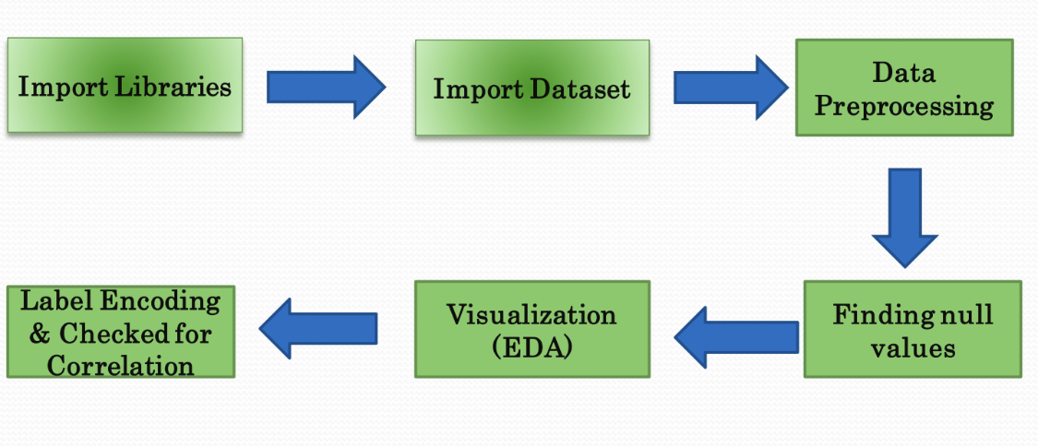
Exploratory Data Analysis (EDA) Steps:

Slide 11
Data Pre-processing Done:
✓ Initially checked for dataset information and types of data it containing.
✓ Then checked for any null values present in the dataset though count function and found no null values. The same was cross checked through heat map also.
✓ Checked for number of unique values in each column, so that we can find out the duplicates if there are any.
✓ Merged the duplicates into one. Like Mobile Internet and Mobile internet was shown twice with the difference in Capital letter.

Slide 12
Assumptions:
• As we have not collected the data, we are assuming it was collected from actual online shoppers.
• All the ethical measure followed during data collection process.

Slide 13
MODEL/S DEVELOPMENT AND EVALUATION
Identification of possible problem-solving approaches (methods):
✓ Used “.replace()” function to replace unwanted entries in the columns.
✓ Used “Label Encoder” method to encode the categorical features into numerical.
✓ Used “Pearson’s method” to check the correlation between the features.
✓ Performed both univariate and bivariate analysis using seaborn and matplotlib

Slide 14
Visualizations
Visualizations: Performed both univariate and bivariate analysis to visualize the data. In univariate analysis, have used pie plots, count plots and in bivariate analysis count plot is used.

Slide 15
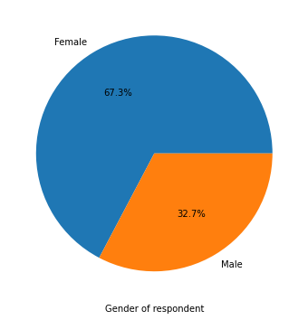
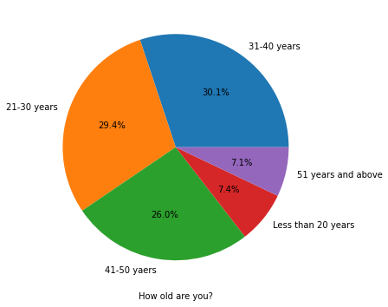
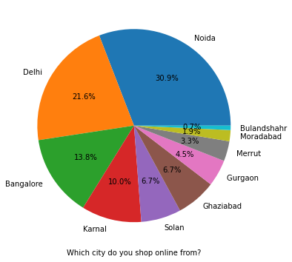
Visualization

Slide 16
Observations
These pie plots shows that the most of the shoppers are from female gender and in between the age group 31-50 years.
2/3 rd of the people are female who were shopping.
Around 60% of people are in age group of 21-40
Most of the shoppers are from Noida(Including Greater Noida) and Delhi
More than 50% population is >3 years old customers

Slide 17
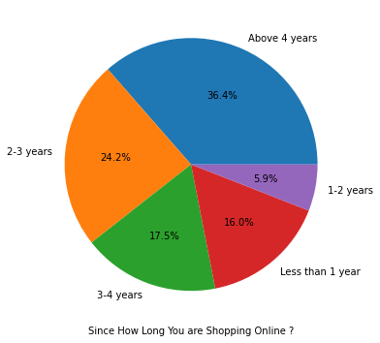
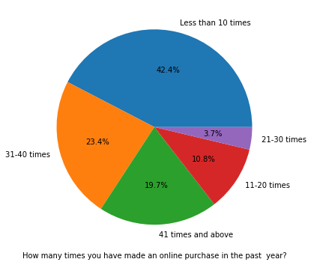
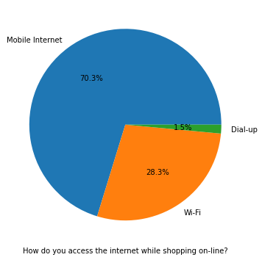
Visualisations

Slide 18
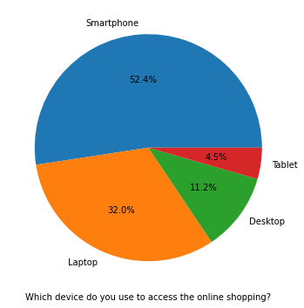
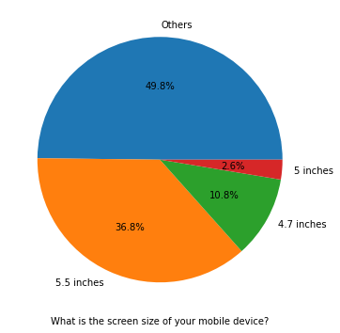
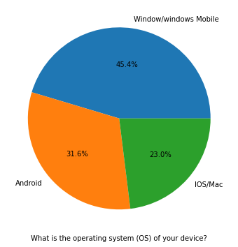
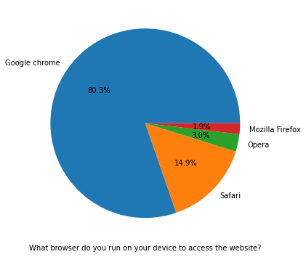
Visualisations

Slide 19
Consumer Preferences for shopping¶
Consumer Preferences for shopping¶
Most of customer access internet for shopping online through Smartphone and Mobile internet which is 70%.
Mostly used OS is windows or windows mobile.
To access the website mostly used browser is google chrome.
Most of the customer uses search engine to arrive at their favourite online store.
Customer explore more than 15 mins to make any purchase decision.
Moslt of the customer feels using credit/debit cards for making paymet online more convinient.

Slide 20
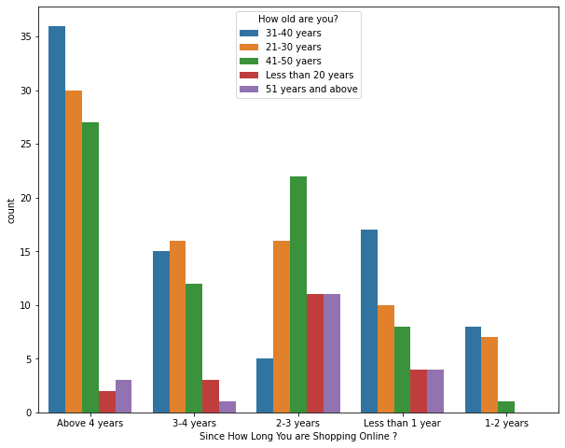
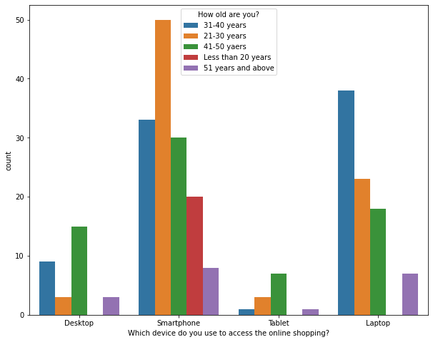
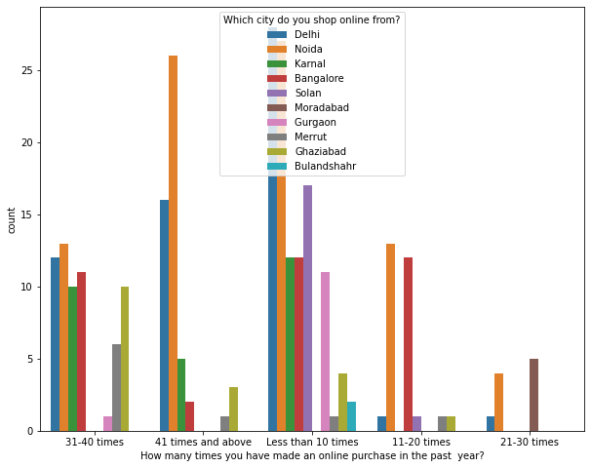
Visualisations

Slide 21
Observations
Most frequent shoppers are using mobile internet for shopping
Most of the customers access the shopping websites more than 31-40 times in 1 year through Mobile Internet to shop the products also most of the customers who used mobile internet to access the online shopping website made online purchase less than 10 times in a year. And only few of the customers used WiFi network to access the shopping store.

Slide 22
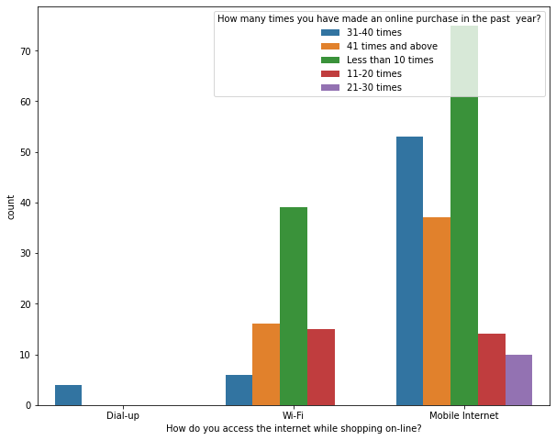
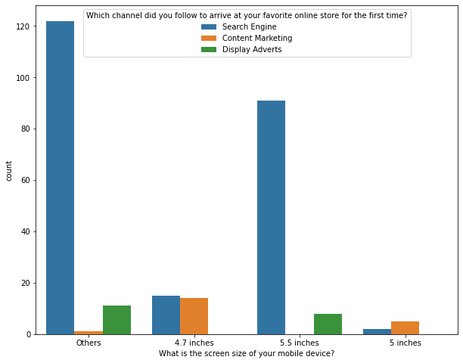
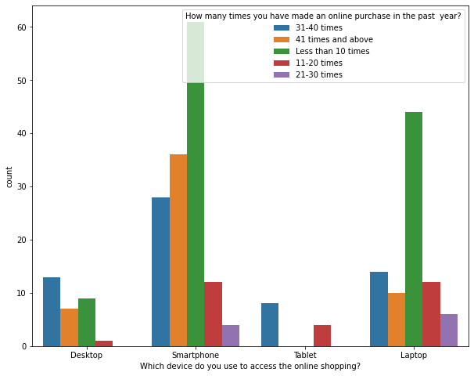
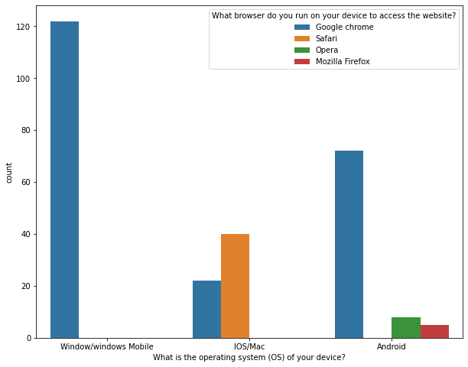
Visualisations

Slide 23
Observations
The customers having their mobile screen size say 6 inches(others) have followed search engine channel to arrive at their favorite online store for the first time. Also the customers who have their screen size 5.5 inches also used search engine channel to access the online shopping store.
Most of the customers used Smartphones 31-40 times in an year to access the ecommerce websites to shop the products. Many customers having windows operating system in their device ran Google chrome to access the ecommerce shopping websites and some of the customers having IOS/Mac operating system used Google chrome as well as Safari to reach the online shopping store.

Slide 24
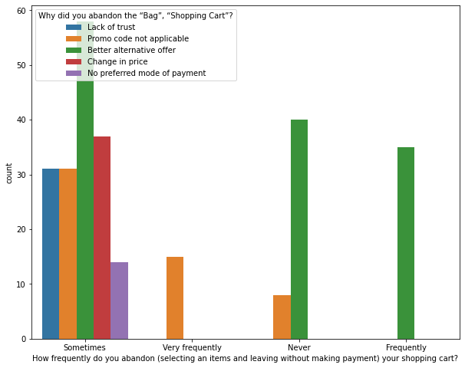
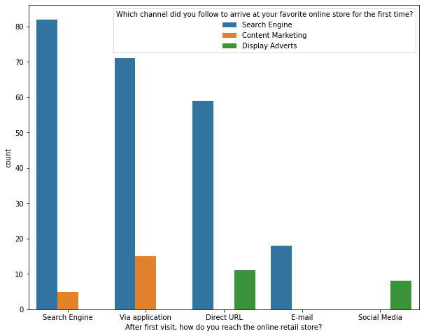
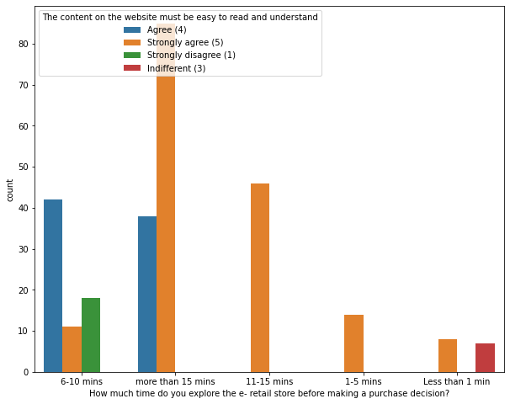
Visualisations

Slide 25
Observations
Due to Lack of trust on the e-commerce websites, sometimes most of the customers abandoned the websites and some of the customers abandoned the shopping website due to the promo code not applicable. which means, if the product is having the special price or some catalogue price rule is applicable on it.Then coupon code should not be applicable on the products.
Search engine is the most used channel by the customers to arrive their favourite store for the first time and after visit the website for the first time, most of them used the same channel to reach the online retail store to re-shopping the products.
Most of the customers agreed that the content on the website is easy to read and understand also they explored more than 15 mins before making the purchase decision and some of the customers strongly disagreed that the content is not good and they explored 6-10 mins before making the purchase decision. So e-commerce websites should enable some images and it should contain clear structure, so that the customers can easily read and understand the content of the product.

Slide 26
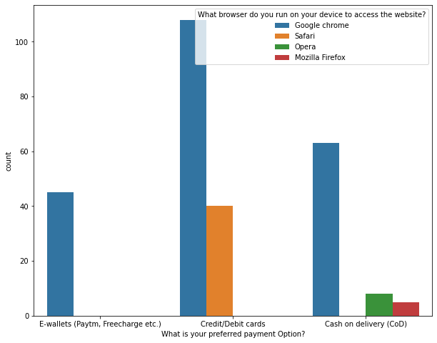
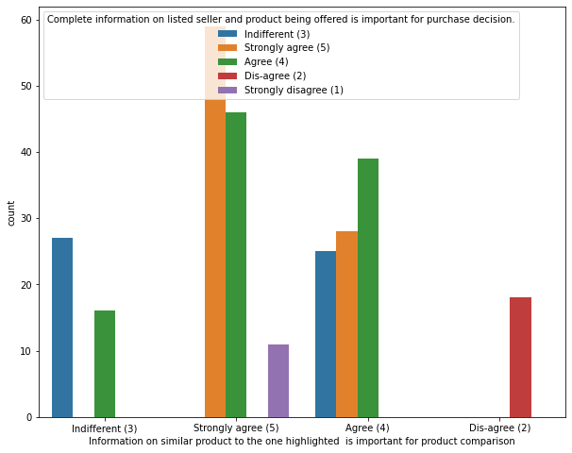
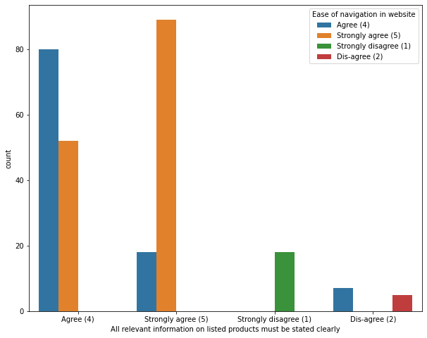
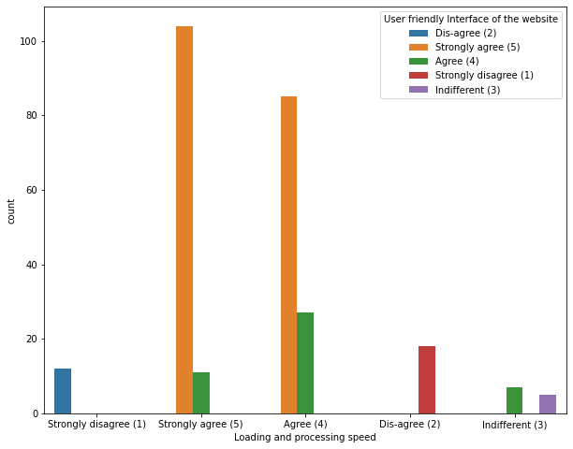
Visualisations

Slide 27
Observations
Most of the customers used google chrome to reach the websites and they preferred to pay their product price using Credit/Debit cards and only few of the customers used Safari browser to reach the e-retail websites.
Most of the customers agreed that the information on similar product to the one highlighted is important for product comparison and also Complete information on listed seller and product being offered is important for purchase decision. In order to buy a product, the ecommerce website must give the complete information about the product and seller information then only the customers can compare the product costs and its details in different websites and they tend to buy that particular product in a particular website.

Slide 28
Observations
Around 90% of the customers agreed that they should be able to navigate the website easily and the products information in the website must be clearly stated their uses, lifetime, benefits etc.Then only more customers tend to buy those products and can shop easily.
Most of the customers agreed with the user friendly interface of the websites which can be easily loaded and processed also these websites' loading and processing capacity is very fast so that the customers like to shop in ecommerce websites. If these websites do not have this much of loading and processing speed then customers don't want to buy the products in this website and they tend to other websites or other options rather than this.

Slide 29
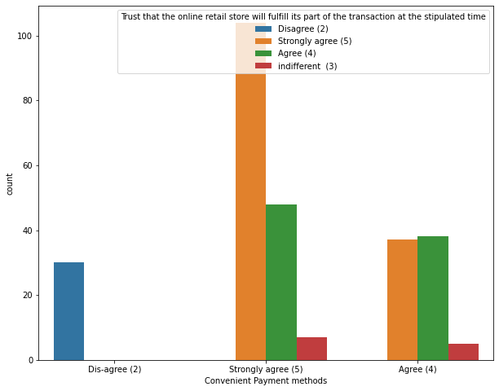
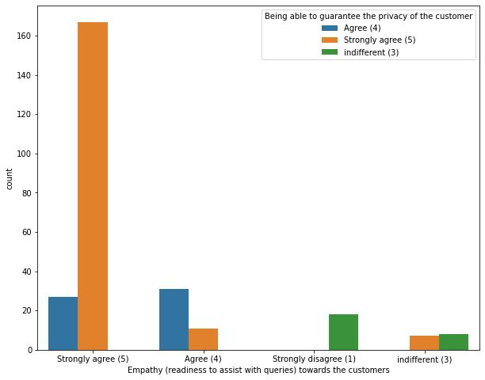
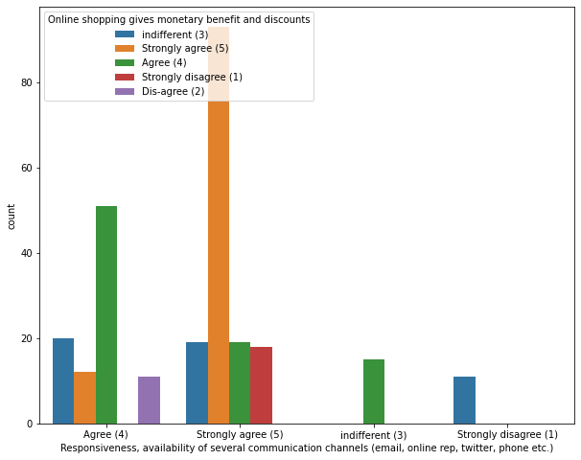
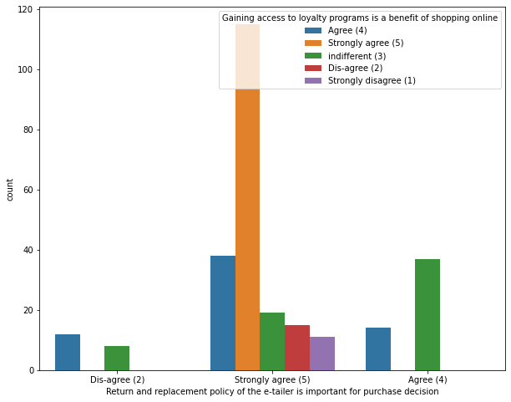
Visualisations

Slide 30
Observations
Most of the customers agree to the trust that the online retail stores will fulfil its part of the transaction at the stipulated time also most of them are very happy with the convenient payment modes given by the websites.
Almost all the customers agreed that e-commerce websites have empathy towards the customers and these sites being able to guarantee the privacy of the customers. The online retailers should be able to resolve all the queries of the customers and they have to assure that the customers credentials are secured and confidential. If the websites guarantees the privacy, it is seen that the customers feel safe to shop onlone and likely to shop more, which will enhance the companies sales.

Slide 31
Observations
Most of the customers agreed that the online shopping gives monetary benefits and responsiveness, availability of several communication channels will help them more while shopping online which means if one channel is not available then customers can easily reach out to other channel to fulfil their benefits. So, it is important for the online e-tailer companies to provide various channels to communicate with the customers. The e-commerce websites should ask the feedback regarding their services, ratings of the products, reviews etc and also they try to communicate with the customers in different social platform then only customers get satisfied by the e-tailers sites and make more shopping on the particular websites regularly which intends to increase the sales of the company. If one website gives less price and more discount for particular product then the customers tend to shop more in that particular website. So, the companies must try to give less price then customers like their offers and retention also increases.

Slide 32
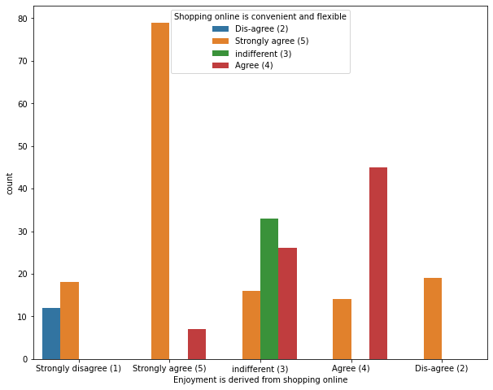
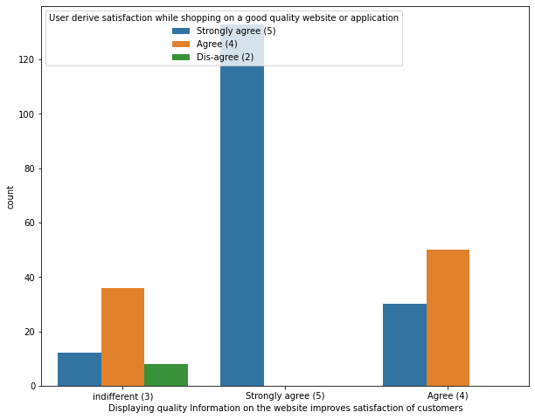
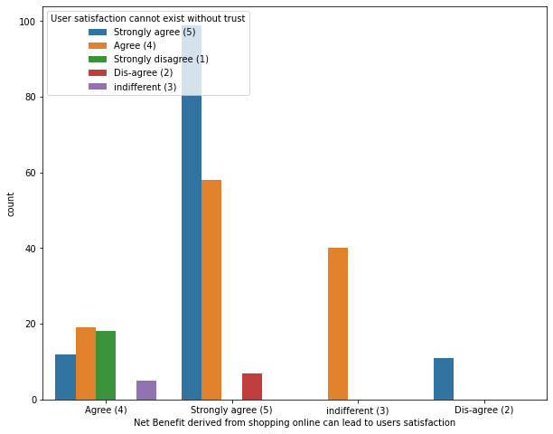
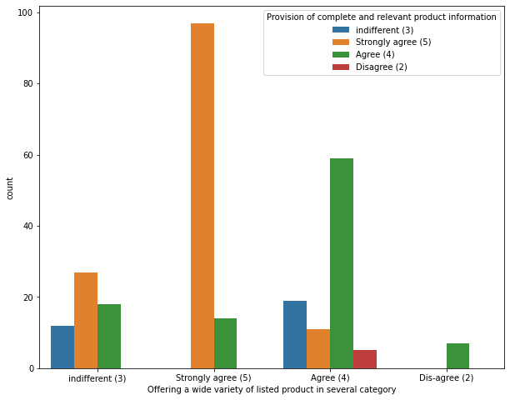
Visualisations

Slide 33
Observations
Most of the customers believed that they enjoy online shopping also shopping online is convenient and flexible and some of the customers who disagreed with the enjoyment of the shopping, they are not convenient with the online shopping. Some customers shops online for their enjoyment purpose they are termed to be hedonistic, for them shopping online gives experiential satisfaction. They contribute much for the ecommerce companies by buying all the costly products randomly. Most of the customers agreed that return and replacement policy of the e-tailer is important for purchase decision also gaining access to loyalty programs is a benefit of shopping online. Many return policies have conditional agreements, such as time limits, that must be clearly defined and expressed at the time of purchase or else the customers won't get the chance to return their damaged or dissatisfied products due to this they may not access the same website if they want to shop again. It is evident from the fact that the customers actually not liking the products completely, they are just purchasing the products and returning them in case of any dissatisfaction. So it is important for the online shopping websites to make easy return and replacement policy if they want to retain their customers. Also, by gaining access to loyalty programs, the customers get more and more rewards, increasing their engagement rate and thus bringing more profit to both company and customer.

Slide 34
Observations
Many customers agreed that displaying quality information on the website improves satisfaction of customers since they believe that displaying quality information have significant association with customer satisfaction and they are satisfied and happy while shopping on good quality websites. In order to obtain high levels of customer satisfaction, high service quality is needed, which often leads to favourable behavioural intentions also a website with good system quality, information quality, and electronic service quality is a key to success in e-commerce. So, the online e-tailers must display all the information about the product then only customers get an idea to buy the products regularly.

Slide 35
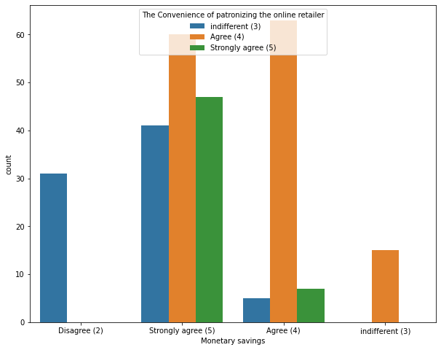
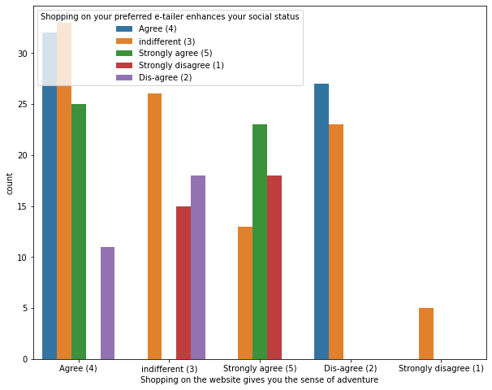
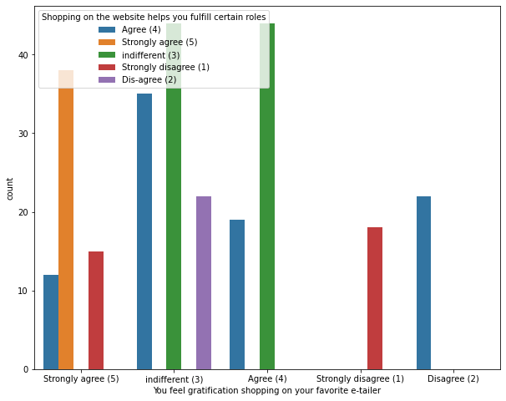
Visualisations

Slide 36
Observations
Most of the customers agreed that shopping on the website gives the sense of adventure. The adventures in the shopping websites gives positive activity to experience an amplified enjoyment to the customers while shopping on websites. They also believe that shopping on preferred e-tailer enhances the social status of the customers. Many customers think they are adventuring while shopping online as they search for low cost and high discount products to buy and prefer the same to the others. In this way they think that shopping in the website gives them the adventure.
Shopping online won't affect anyone's status and the customers agreed that shopping on preferred e-tailer enhances their social status.

Slide 37
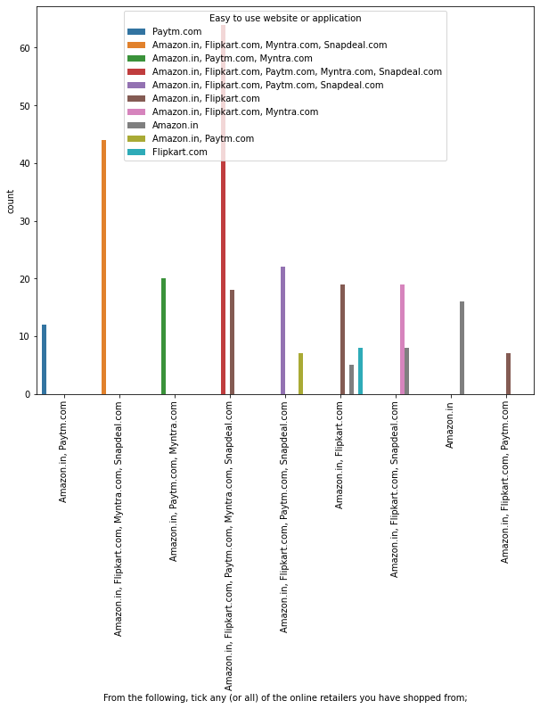
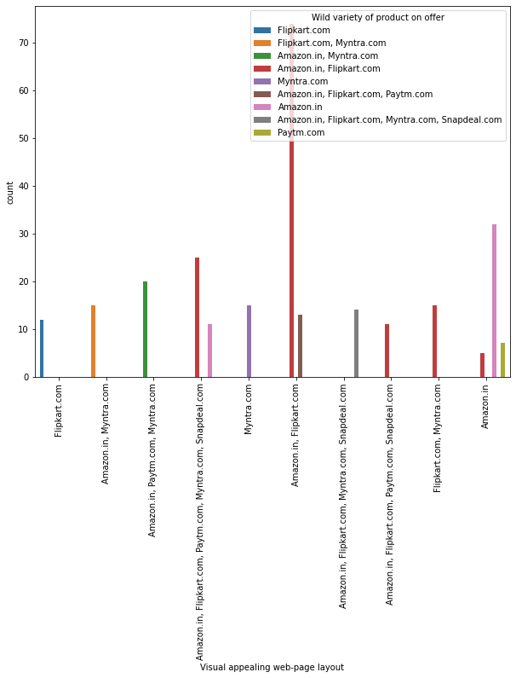
Visualisations

Slide 38
Observations
There are many websites for selling the products among them Amazon.in, Flipkart.com, Paytm.com, Myntra.com, Snapdeal.com are easy to use and shop. Most of the customers used these websites more, this is because, these websites may provide less price products, good discounts and may have lots of varieties of similar products with different brand. Amazon and Flipkart have high visual appealing web-page layout compared to others that means these websites provides some colourful graphics on the homepage. The more people find the website attractive, there are higher chances that they will stay a little longer in that website, also these websites provide wild variety of products in an attractive manner which makes the customers to buy the product.

Slide 39

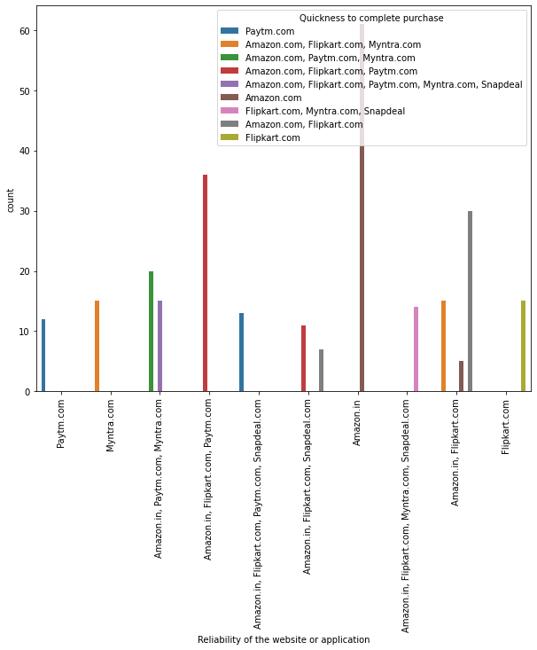
Visualisations

Slide 40
Observations
From the plot we can visualise that the amazon and flip kart websites gives complete and relevant information and these websites have no issue with the server and most of the customer liked the web speed of both amazon and flip kart
From the plot we can notice amazon site is more reliable and most of the customers complete their purchase on amazon very quickly

Slide 41
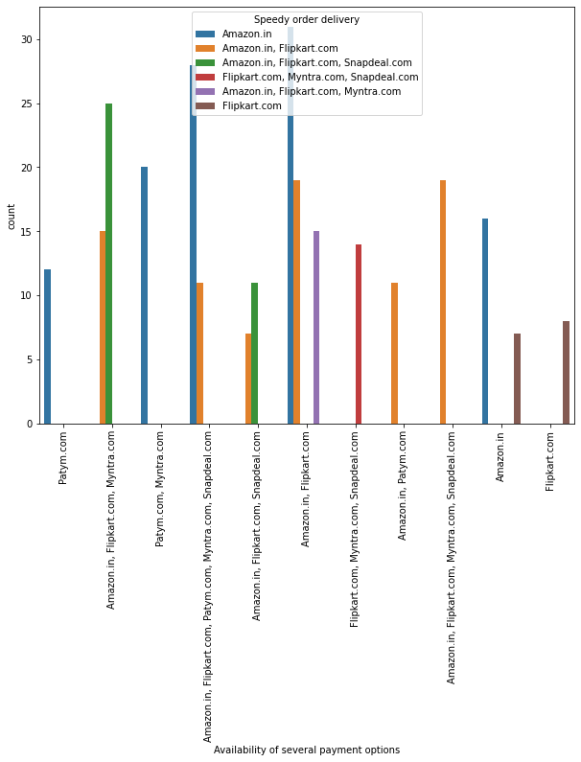
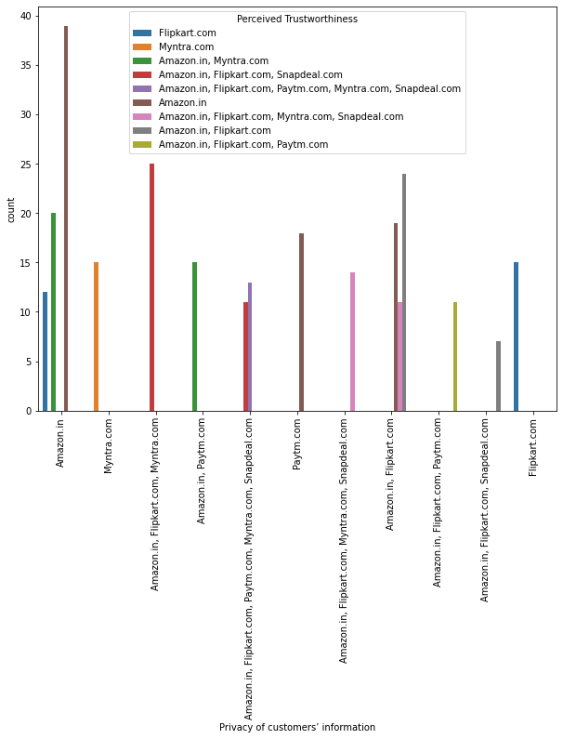
Visualisations

Slide 42
Observations
Having different types of payment methods will helps the customers to pay the invoice easily using their choice of payment and if the websites have speedy delivery methods without delivery charge, then the customers like to buy the products in those websites.
Here amazon and flip kart have several payment options and amazon indeed has speedy order delivery compared to other websites.
Most of the customers trusts amazon followed by flip kart in terms of keeping their privacy of data information secured and the customers who believes that amazon website keeps their financial information as secrete also trusts flipkart, Myntra, Snapdeal and Paytm in terms of keeping their financial information secured. Most of the customers believed that Amazon has perceived trustworthiness compared to others. Apart from this, customers believed that flip kart and Myntra also have perceived trustworthiness.

Slide 43
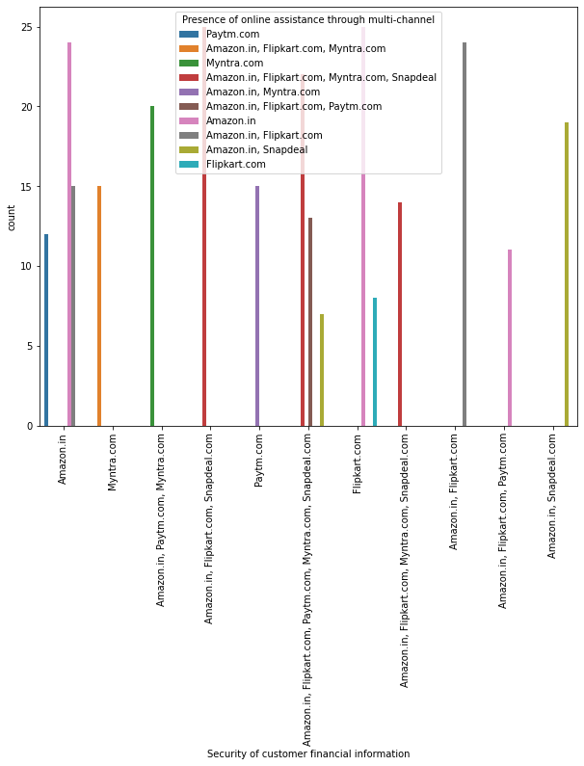
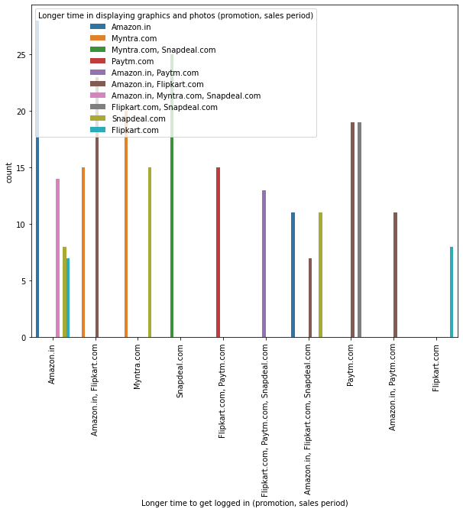
Visualisations

Slide 44
Observations
The customers trusts that amazon and flip kart keeps their financial information private and they never share any type of information to others.
Multi-channel retailing provides several benefits which includes several shoppers like the convenience that is provided through online channels in comparison to physical stores. Most of the customers like Amazon in terms of presence of online assistance through multi-channel.
From the above amazon being the lagging app, as it takes longer time to load and display the graphics along with snapdeal and myntra, and flipkart is the faster.

Slide 45
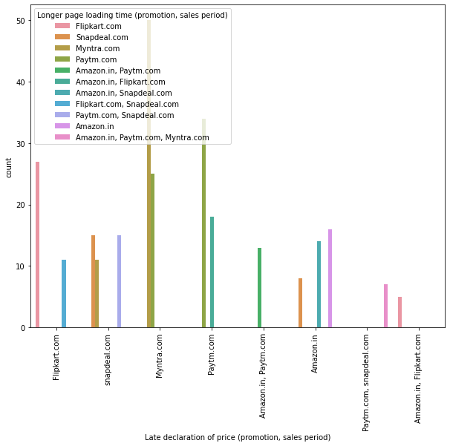
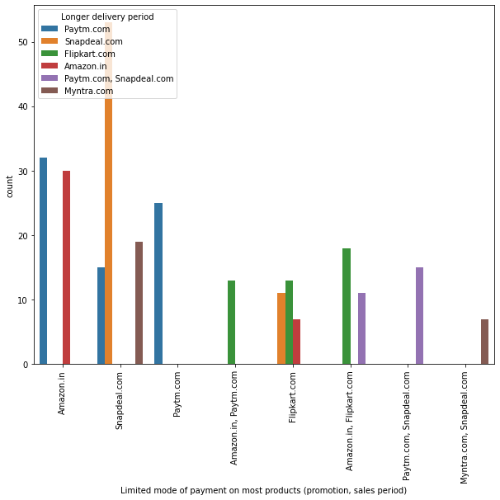
Visualisations

Slide 46
Observations
When there is promotion and sales, Myntra takes time ti load the page and it has late declaration of price in these days. Myntra declare the late price in order to clear the sales and they fix the price by comparing with other websites and they end up sales by providing benefits to the customers. In this time most of the customers tries to shop in this website so it takes long loading time.
Snapdeal has limited mode of payment on most of the products followed by Amazon. And paytm takes more time to deliver the product. So this website may not satisfy the customers due to late delivery.

Slide 47
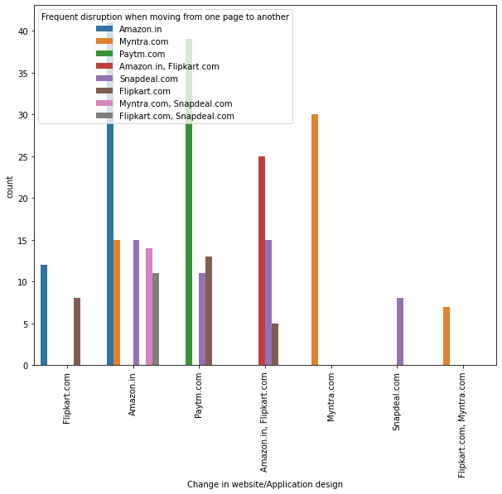
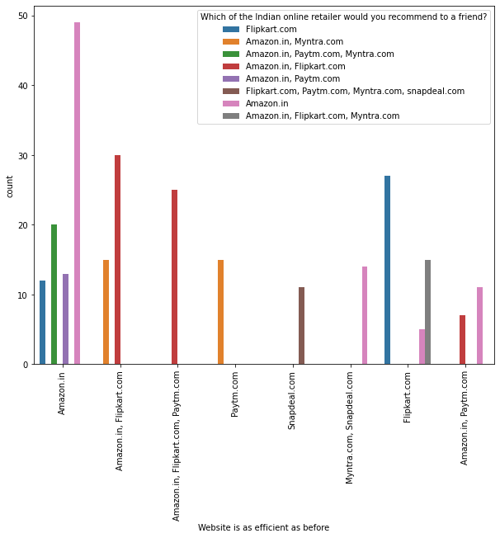
Visualisations

Slide 48
Observations
Amazon is the website where they frequently change their application designs in order to attract the customers and satisfies the customers’ needs and they tend to make customers by updating everyday as per the trend. But the disadvantages of this website are when moving from one page to other it slows down and sometimes it may shutdown.
Amazon is the website which is more efficient as before and I suggest Amazon.com and Flipkart as a best Indian online retailer store for purchasing all types of products, as they provide enormous amounts of benefits.

Slide 49
Conclusions
Amazon is the website which is more efficient as before and I suggest Amazon.com and Flipkart as a best Indian online retailer store for purchasing all types of products, as they provide enormous amounts of benefits.
Amazon is the website where they frequently change their application designs in order to attract the customers and satisfies the customers’ needs and they tend to make customers by updating everyday as per the trend. But the disadvantages of this website are when moving from one page to other it slows down and sometimes it may shutdown.

Slide 50
Conclusions
Transaction security and consumers data safety are principal concerns of online customers purchasing products or services online. Therefore, online vendors can assure their consumers’ by offering personal information privacy, protection policy and guarantee for transaction security by improving their technological systems.
Online sellers can be more concerned about delivery times, delivery charge and product return policies. They can make it easier, quicker and reliable, so that consumers can enjoy the online shopping experience and they likes ti shop in the particular websites regularly

Slide 51
Conclusions
Getting feedbacks from the customers is also on of the important thing to improve the sales of the company. The e-tailer wants to keep the customer happy in order to build the successful business, but they easily fall into a trap of assuming that the customers will give feedback without being prompted. If the e-retailers are doing something wrong, most of the customers won’t complain, they will just go elsewhere. So, it is important to ask customers how they really feel about their services

Slide 52
THANK YOU

